Slide 1
5C
SUN AND THE CITY

Slide 2

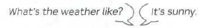

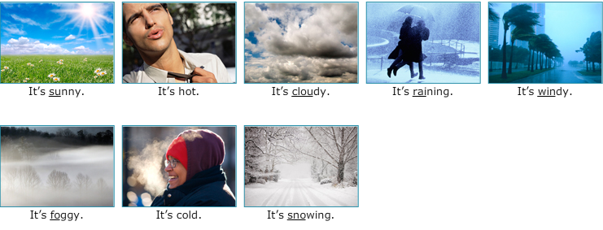
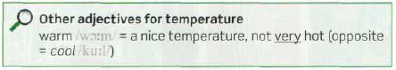

Slide 3
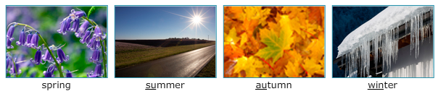
THE FOUR SEASONS
fall
What +be + noun + like= ¿Cómo es? (Give me a description)

Slide 4
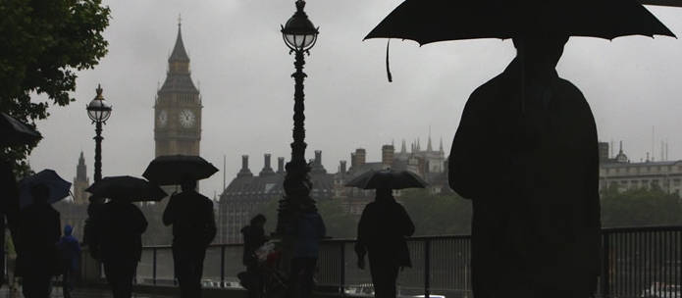
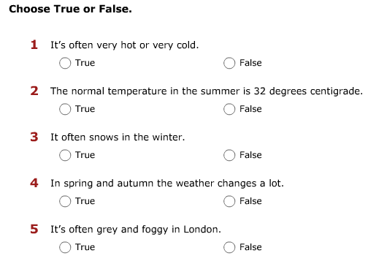
Listen to a travel guide talking about the weather in London
Extreme
Hot
Cold
summer
Sunny
Cloudy
Degrees
Rains
winter
Windy
Cold
Snows
spring and autumn
Changeable
Sunglasses
Umbrellas
--------
Fog/foggy
Dirty/ clean

Slide 5
The best thing about the weather in London is that it’s never extreme. It isn't usually very hot or very cold.
In the summer it’s sometimes sunny and sometimes cloudy, with temperatures of about 22 degrees. And of course it sometimes rains.
In winter the temperature is usually between 0 and 10 degrees. It can be windy and cold, but it hardly ever snows.
In spring and in autumn the weather is very changeable – you can have all the four seasons in one day! It can be sunny in the morning, cloudy at lunchtime, raining in the afternoon, and then cold and windy in the evening.
I always tell tourists to take their sunglasses and their umbrellas when they go out!
But one thing you don’t often see these days in London is fog. A lot of tourists come to London and say ‘Where’s the fog? London is always foggy in films!’ Well, it’s true that, in the past, that is until the 1950s, London was a very foggy city because the air was really dirty. But today the air is clean and it’s hardly ever foggy.

Slide 6
What season is it? What’s the weather like?

Slide 7
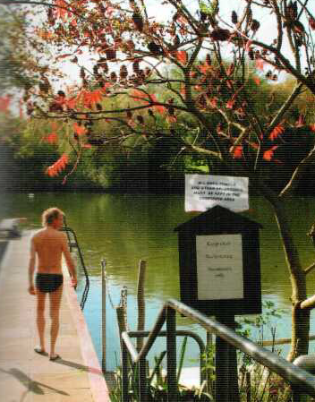
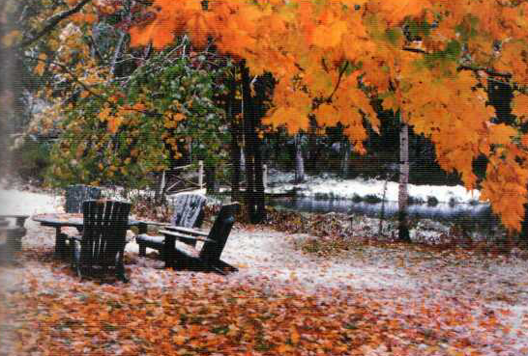
What season is it? What’s the weather like?

Slide 8
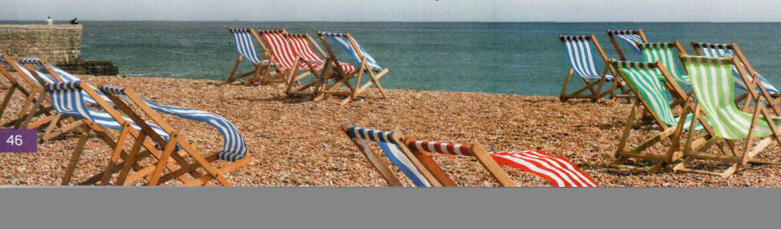
What season is it? What’s the weather like?

Slide 9
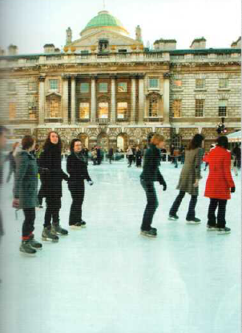
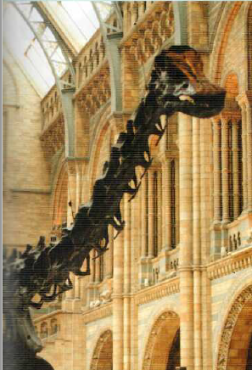
What season is it? What’s the weather like? What can you do?
Go ice skating
Go to a museum

Slide 10
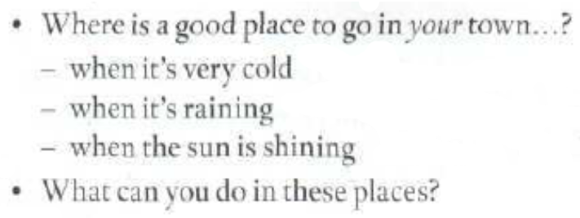
WHAT’S THE WEATHER LIKE IN MENDOZA?

Slide 11
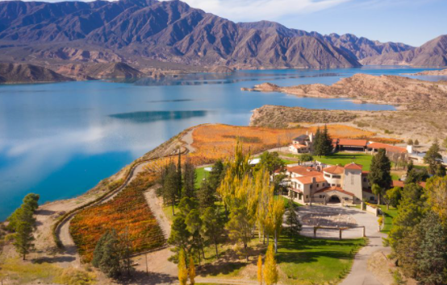

Slide 12
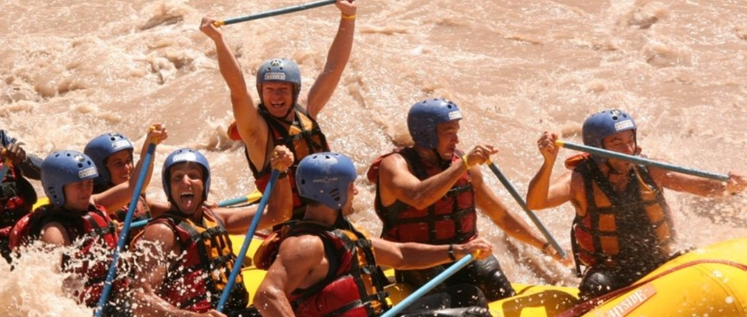
Go rafting

Slide 13
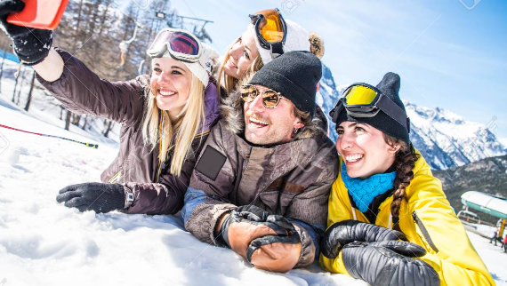
Go to the mountains
Go skiing

Slide 14
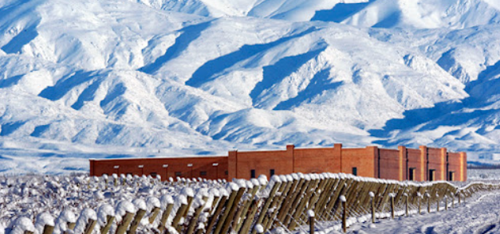
Go along the Wine Road
Go to visit a winery

Slide 15
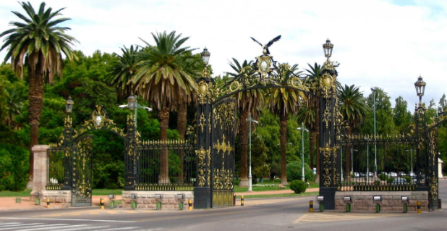
Go to the park
Go for a walk in the park

Slide 16
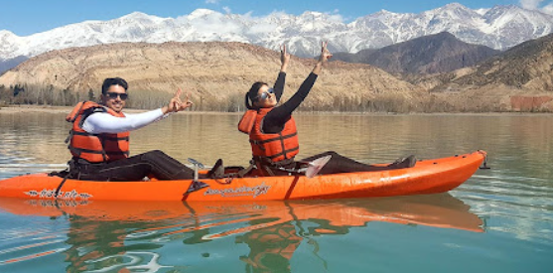
Go kayaking

Slide 17
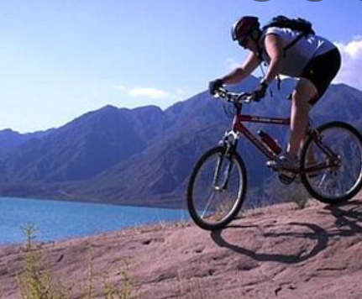
Go cycling

Slide 18
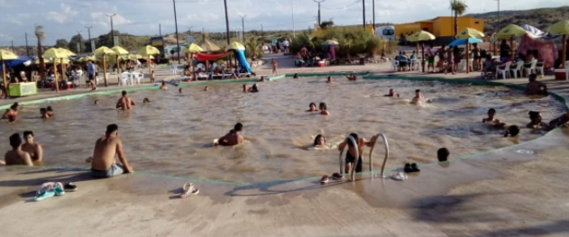
Go swimming

Slide 19
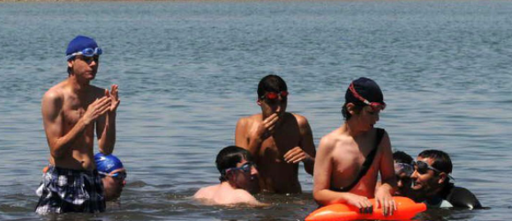

Slide 20
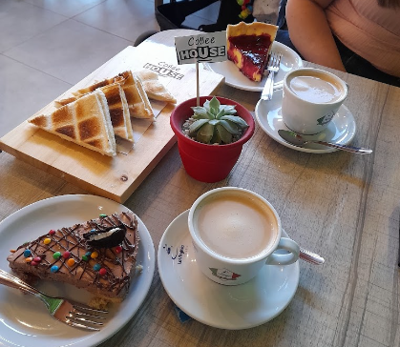
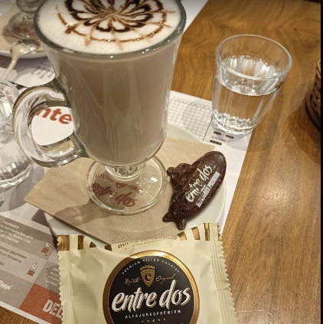
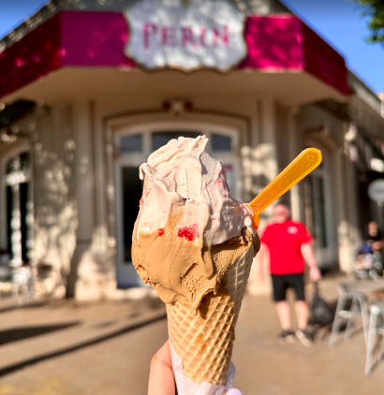
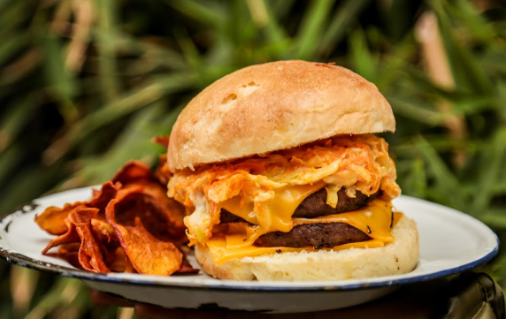

Slide 21
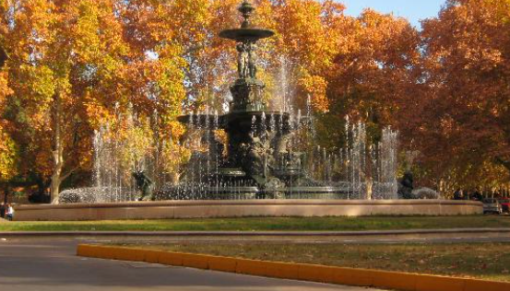
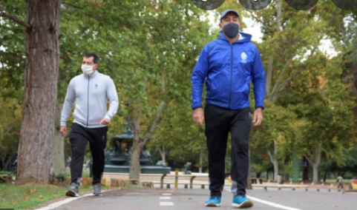
Go walking

Slide 22
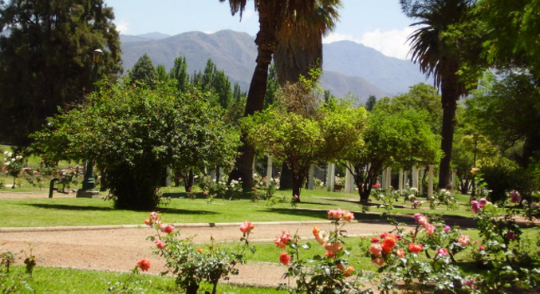

Slide 23
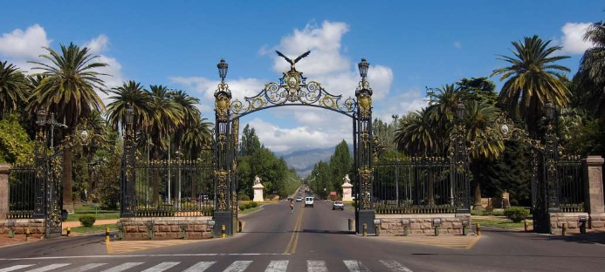

Slide 24
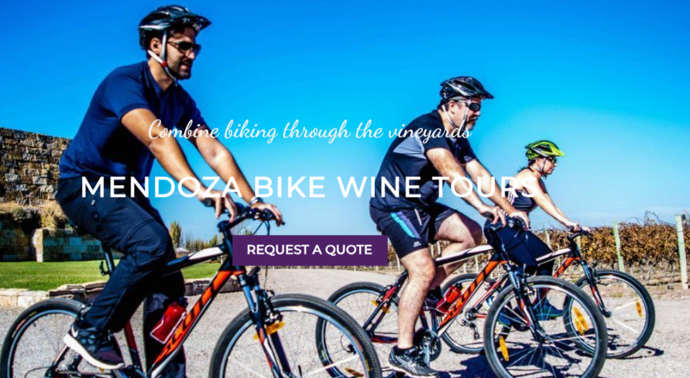

Slide 25
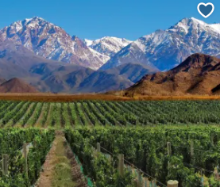
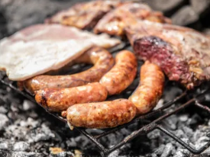
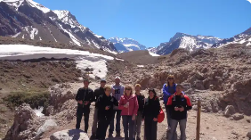
Take a mountain tour

Slide 26
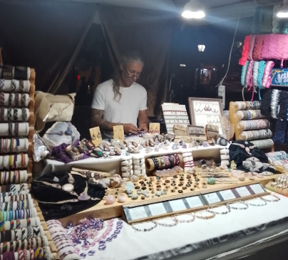
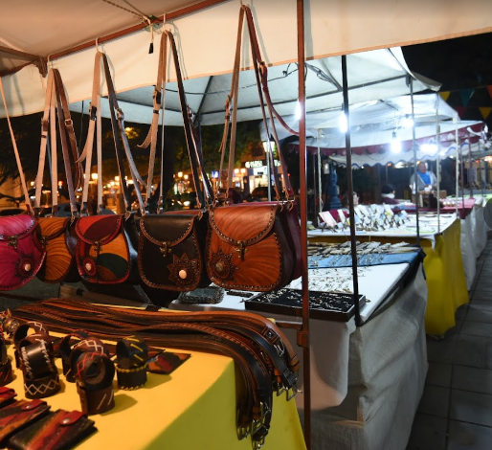
Buy souvenirs

Slide 27
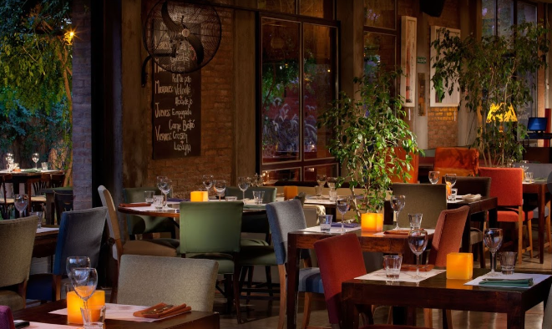
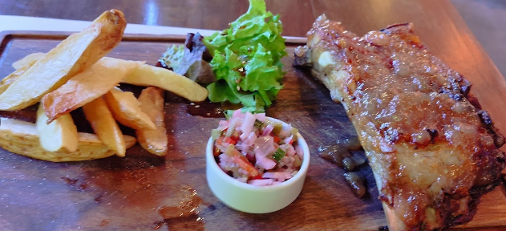

Slide 28
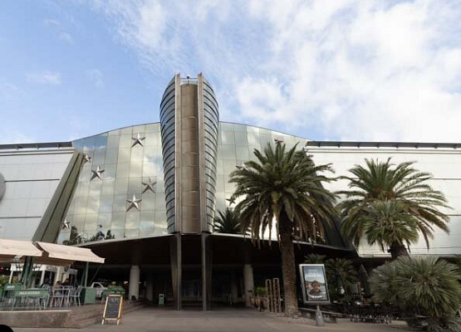
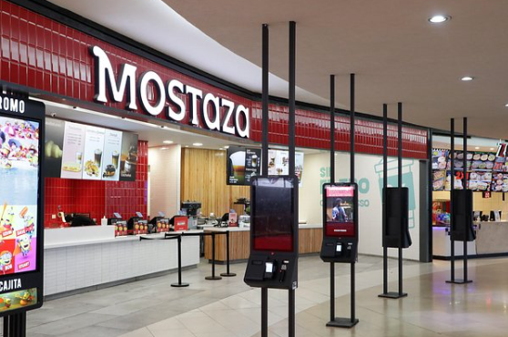
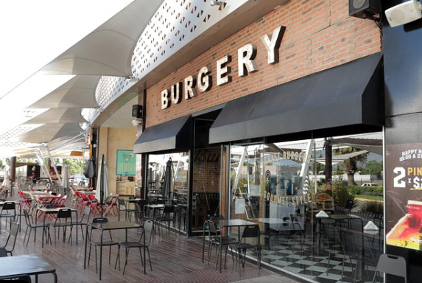
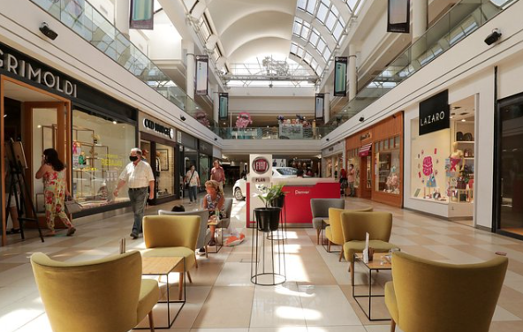

Slide 29
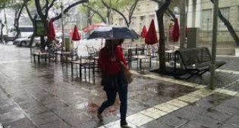
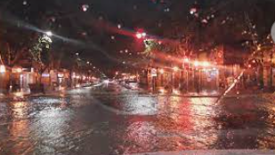

Slide 30
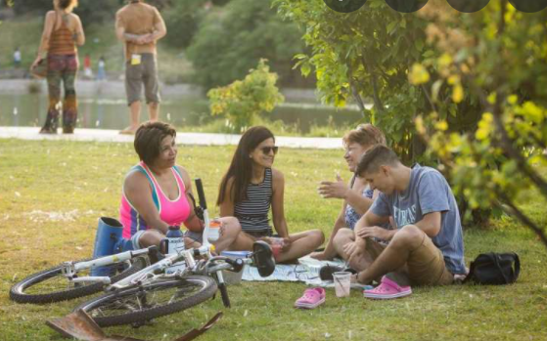
Go for a pic nic

Slide 31
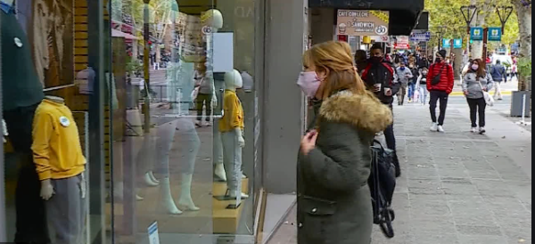
Go shopping

Slide 32
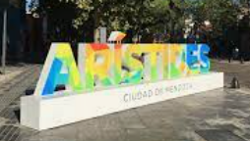
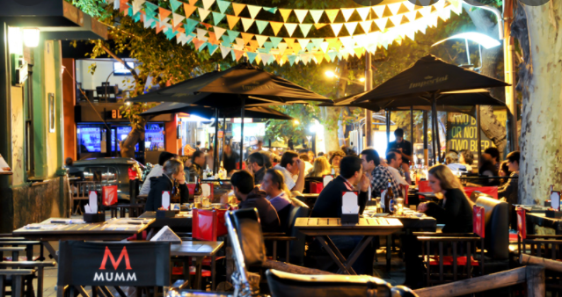
Go to a restaurant or to a pub

Slide 33
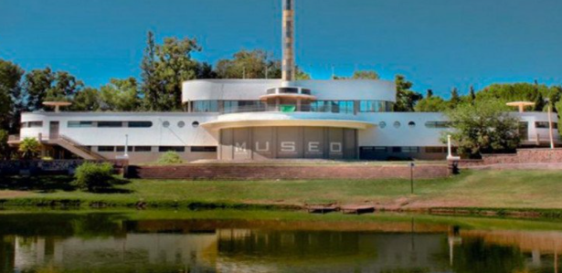
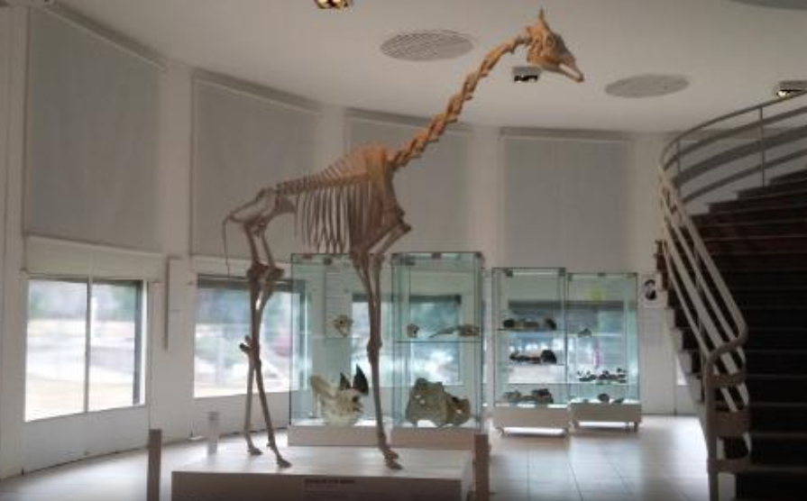
Go to a museum
See collections and exhibits

Slide 34
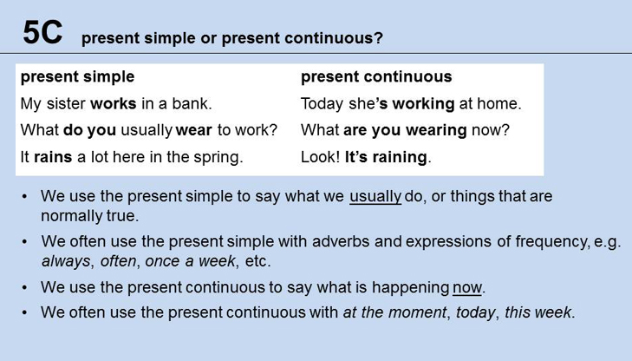

Present simple: always, sometimes,… Present continuos: at the moment, right now, these days …

Slide 35

PRESENT CONTINUOUS

Slide 36


Slide 37

are
doing
‘m waiting
Do
like
don’t eat
are having
have
does
do
works
are
going
go

